Slide 1
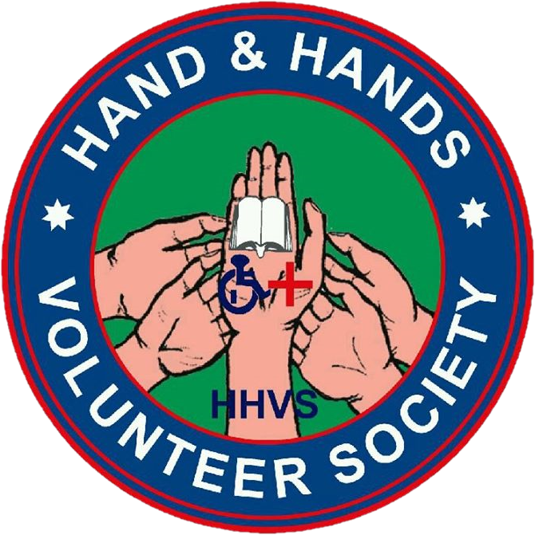


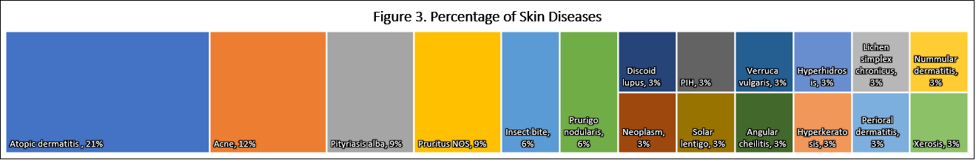
Prevalence of Skin and other Diseases in Bhotang, Nepal
David Chang, BS¹, Lee Nguyen, BS¹, Raja K. Sivamani, MD, MS, CAT¹
¹Department of Dermatology, University of California, Davis, Jai Nepal Health Team, Motherland Hospital Pvt. Ltd, Hand and Hands Volunteer Society-Nepal
BACKGROUND
GENERALIZED PATIENT COMPLAINT DATA
RESULTS
Nepal is a country with over 26.6 million inhabitants, yet 82% of its population reside in rural and remote communities with limited access to health care.
Nepal’s diverse culture, political landscape, topography, inadequate infrastructure, lack of resources, and shortage of healthcare providers has further complicated the nation’s ability to provide adequate health care in these communities.
The Ministry of Health and Population of Nepal reports that skin disease is the 4th most common cause of outpatient consultation and continues to be a significant cause of morbidity throughout the country.
The Jai Nepal Health Team is comprised UC Davis SOM faculty physicians and medical students. Working together with Hand and Hands Volunteer Society (HHVS) and Nepali health care providers, a health camp in the rural, hilly, village of Bhotang was organized in 2016.
Table 1. Generalized Patient Complaints (n=142)
Complaint / Symptoms | Mean Age | Male | Female | Total Cases | Point Prevalence
Dental | 17.06 | 14 | 19 | 33 | 23%
Skin | 19.48 | 20 | 7 | 27 | 19%
Musculoskeletal | 45.52 | 8 | 17 | 25 | 18%
Respiratory | 17.30 | 10 | 10 | 20 | 14%
Eye / Vision | 24.95 | 8 | 12 | 20 | 14%
GI | 36.37 | 7 | 12 | 19 | 13%
Headache | 18.86 | 4 | 10 | 14 | 10%
Fever | 22.75 | 3 | 5 | 8 | 6%
Ear / Hearing | 29.29 | 4 | 3 | 7 | 5%
GU | 37.83 | 0 | 6 | 6 | 4%
Weakness / Fatigue | 52 | 3 | 3 | 6 | 4%
Other | 37 | 2 | 1 | 3 | 2%
Trauma | 23.50 | 2 | 0 | 2 | 1%
A total of 150 patients were seen by physicians during the health camp.
142 patients were included in the study. 8 patients were excluded from the study due to an illegible or blank patient care sheet.
Dental complaints were the most common and seen in 23% of patients (Figure 1).
The 2nd most common complaint was skin disease with point prevalence of 19%. 27 patients were diagnosed with at least 1 skin disease. 6 of the 27 patients were diagnosed with 2 skin diseases.
  Atopic dermatitis made up 21% of skin diseases overserved with a point prevalence of 5% during the health camp (Figure 2).
  Acne and Pityriasis alba were the second most common skin disease, each with a 3% point prevalence.
The 3rd most common complaint was musculoskeletal pain with a point prevalence of 18%.
  Back pain comprised 44% of MSK pain (point prevalence of 8%).
  Joint pain comprised 52% of MSK pain (point prevalence of 9%)
CONCLUSIONS
PURPOSE
Our study demonstrated a 19% point prevalence of skin disease. Similar studies in Nepali rural villages have demonstrated 20%-62% point prevalence of skin disease.
Our data supports other studies and government reports in Nepali villages that skin disease is a large contributor to morbidity in Nepal.
Atopic dermatitis was a leading cause of skin disease. However, other typically associated atopic conditions such as asthma and allergies were absent or minimal. This is counter to the notion that atopic dermatitis is less prevalent in rural setting requires further follow up.
The high prevalence of back and joint pain is concerning, especially as WHO identifies back pain as a leading cause of activity limitation and work absence. Both can be detrimental to impoverished households.
Further studies are needed to develop a thorough assessment of the prevalence of disease in Bhotang and other rural communities in Nepal. Such information can be invaluable for allocating resources based on the needs of each community, improving health, and quality of life.
To obtain a better understanding of the pattern and prevalence of disease in the rural village of Bhotang, Nepal.
To obtain a better understanding of the burden of specific skin diseases in the rural village of Bhotang, Nepal.
SKIN DISEASE DATA
Table 2. Skin Disease
Diagnosis | Mean Age | Male | Female | Total Cases | % of Skin Diseases | Point Prevalence
Atopic dermatitis | 9.86 | 4 | 3 | 7 | 21% | 5%
Acne | 15 | 4 | 0 | 4 | 12% | 3%
Pityriasis alba | 12 | 3 | 0 | 3 | 9% | 2%
Pruritus NOS | 48 | 3 | 0 | 3 | 9% | 2%
Insect bite | 8.50 | 2 | 0 | 2 | 6% | 1%
Prurigo nodularis | 12 | 2 | 0 | 2 | 6% | 1%
Discoid lupus | 17 | 0 | 1 | 1 | 3% | 1%
Neoplasm | 32 | 0 | 1 | 1 | 3% | 1%
PIH | 12 | 0 | 1 | 1 | 3% | 1%
Solar lentigo | 14 | 0 | 1 | 1 | 3% | 1%
Verruca vulgaris | 14 | 0 | 1 | 1 | 3% | 1%
Angular cheilitis | 9 | 1 | 0 | 1 | 3% | 1%
Hyperhidrosis | 35 | 1 | 0 | 1 | 3% | 1%
Hyperkeratosis | 12 | 1 | 0 | 1 | 3% | 1%
Lichen simplex chronicus | 57 | 1 | 0 | 1 | 3% | 1%
Nummular dermatitis | 18 | 1 | 0 | 1 | 3% | 1%
Perioral dermatitis | 16 | 1 | 0 | 1 | 3% | 1%
Xerosis | 10 | 1 | 0 | 1 | 3% | 1%
METHODS
Patients were seen during the 2016 Bhotang health camp by licensed physicians and dentists
Skin complaints were assessed by a board certified dermatologist.
Patients who required further care were referred to Motherland Hospital or other appropriate facilities.
Anonymized/deidentified patient complaints and diagnostic data from the health camp were made available for analysis by HHVS.
Diagnosis information was not recorded in the majority of patient encounters (aside from skin conditions) with only medical complaints, HPI, physical exam, and advice/medications provided recorded.
In lieu of diagnostic data, patient complaints were analyzed for point prevalence and organized in general categories (Table 1).
All skin conditions were formally diagnosed by a board certified dermatologist and analyzed for point prevalence (Table 2).
The anonymized evaluation was exempted by the UC Davis IRB.
REFERENCES
Binamra Basnet, Saraswoti Neupane, Shristi Shrestha, Sujan Gautam. Burden of Skin Diseases in Western Nepal: A Hospital Based Study. American Journal of Public Health Research. Vol. 3, No. 5A, 2015, pp 64-66. http://pubs.sciepub.com/ajphr/3/5A/14
Department of Health Services Annual Report 2066/67 (2009/2010), Kathmandu, Nepal: Government of Nepal, Department of Health Services,2011.
Duthey, B. Priority Medicines for Europe and the World - 2013 Update. Background Paper 6 - Priority Diseases and Reasons for Inclusion. BP 6.24 - Low Back Pain. WHO Collaborating Centre for Pharmaceutical Policy and Regulation (Utrecht University, Netherlands), WHO Collaborating Centre in Pharmaceutical Policy (Boston, United States of America), WHO Headquarters in Geneva 2013:1–29.
National Population and Housing Census 2011, Kathmandu, Nepal: Government of Nepal, Central Bureau of Statistics, 2012.
Shrestha D, Gurung D, Rosdahl I. Prevalence of skin diseases and impact on quality of life in hilly region of Nepal. Journal of Institute of Medicine. 2013;34(3).
Shrestha R, Lama L, Gurung D, SHRESTHA DP, Rosdahl I. Pattern Of Skin Diseases In A Rural Village Development Community Of Nepal. NJDVL. 2016;12(1):41-44.
Shrestha R, Kayastha BMM. Pattern of Skin diseases in a rural area of Nepal. PMJN. 2012;12(2):41-43.
Walker S, Shah M, Hubbard V, Pradhan H, Ghimire M. Skin disease is common in rural Nepal: results of a point prevalence study. British Journal of Dermatology. 2007. doi:10.1111/j.1365-2133.2007.08107.x.
ACKNOWLEDGEMENTS
Many thanks to Dr. Raja Sivamani, Dr. Saul Schaefer, Dr. Michael Wilkes, Dr. Jennifer Wang, UC Davis Global Health/Office of Medical Education/faculty physicians, HHVS, and Motherland Hospital for your guidance, support, and conviction to improve the health and prosperity of Nepal and communities worldwide.

